Slide 1
TestExec.NET
Orifiel Gomez

Slide 2
About Us
Local company servicing U.S. and Mexico
Have been in business for over 15 years
Extensive experience with automation software

Slide 3
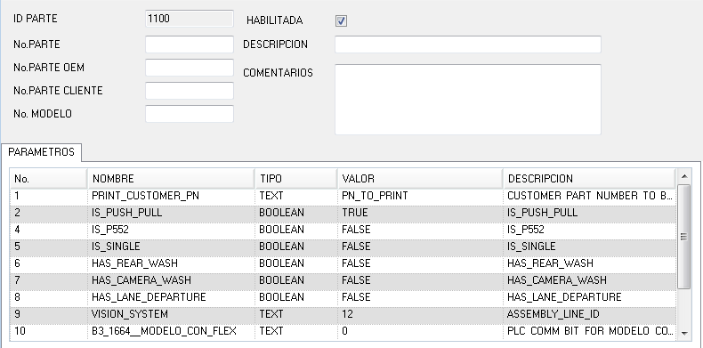
New Platform Features
Unlimited number of Part Parameters (part functions)

Slide 4
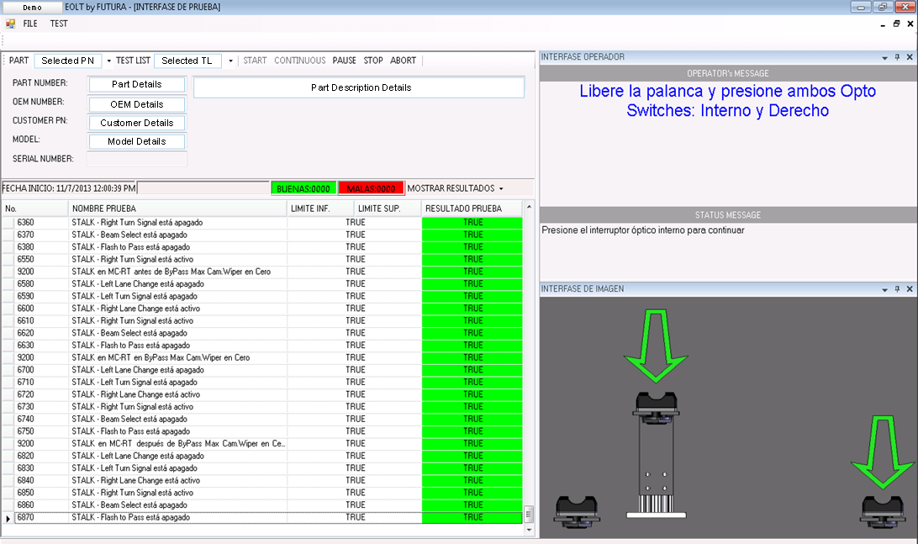
New Platform Features

Slide 5
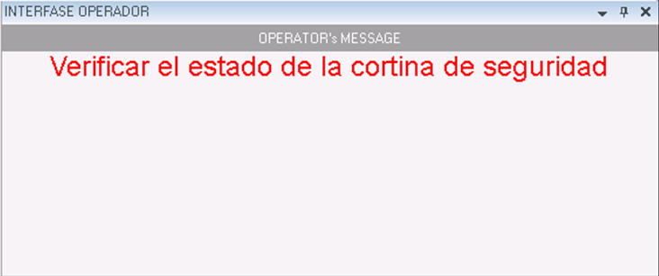
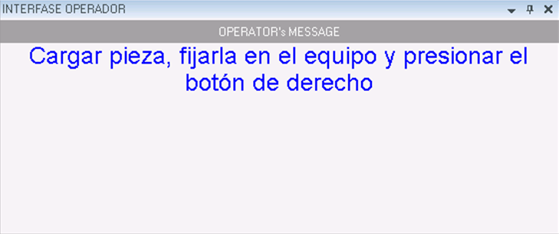
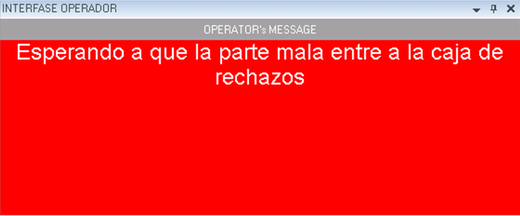
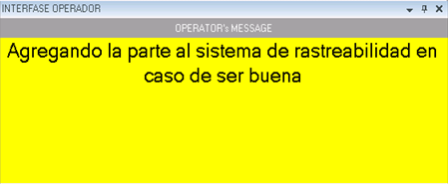
New Platform Features
Operator Interface:
Fonts
Styles
Colors
Background

Slide 6
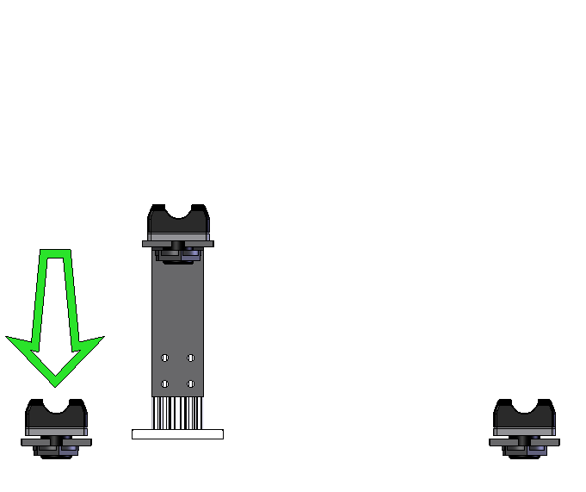
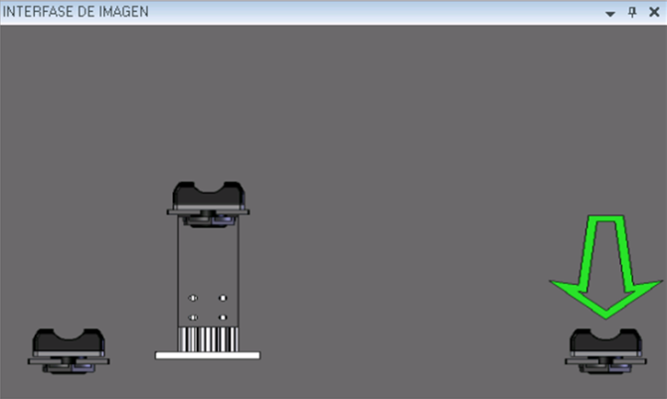
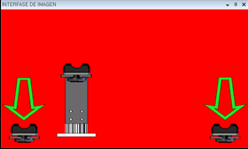
New Platform Features
Operator Interface:
Images
Support for transparent image types
Use of background color for dramatic attention demand
Transparent Image

Slide 7
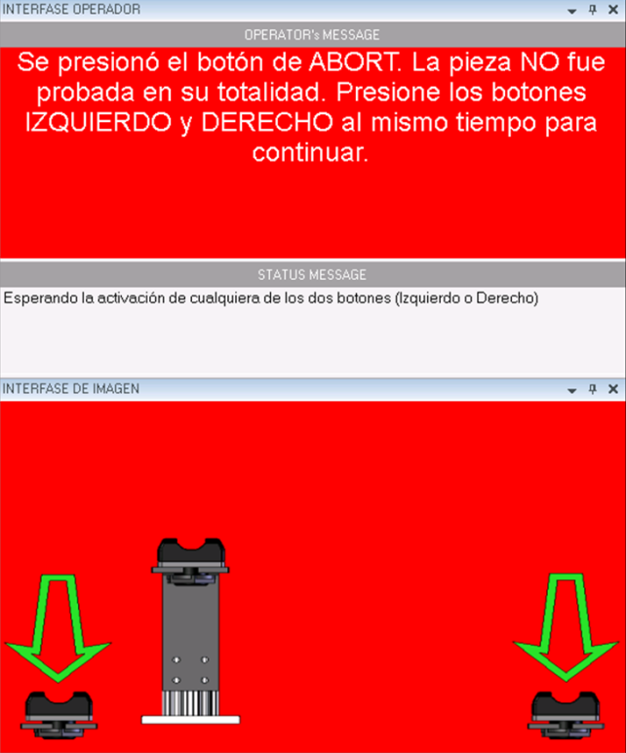
New Platform Features
Instant troubleshooting ability for support personnel

Slide 8
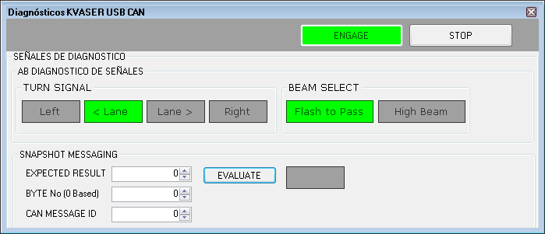
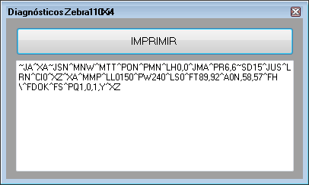
New Platform Features
Custom diagnostics screen for each device

Slide 9
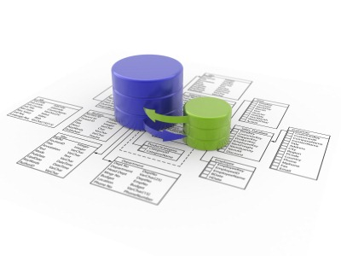
Customizable Features
Information for parts can be remotely edited

Slide 10
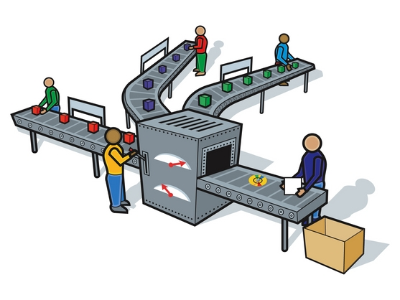
Customizable Features
Progressive Change Over

Slide 11
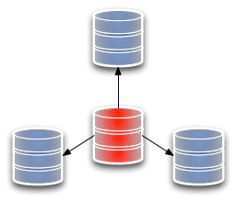
Customizable Features
Master / Slave for regular testers and EOLTs

Slide 12
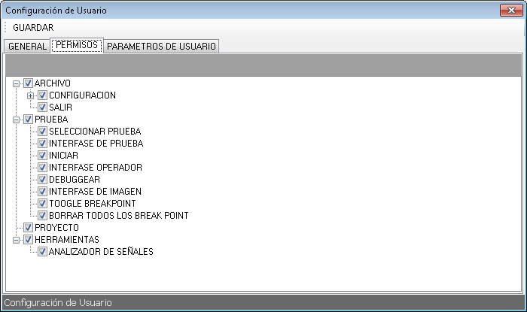
Additional Features
Designed with Multi-User / Multi-Level methodology

Slide 13
Additional Features
Designed with Multi-Language / Multi-Culture in mind

Slide 14
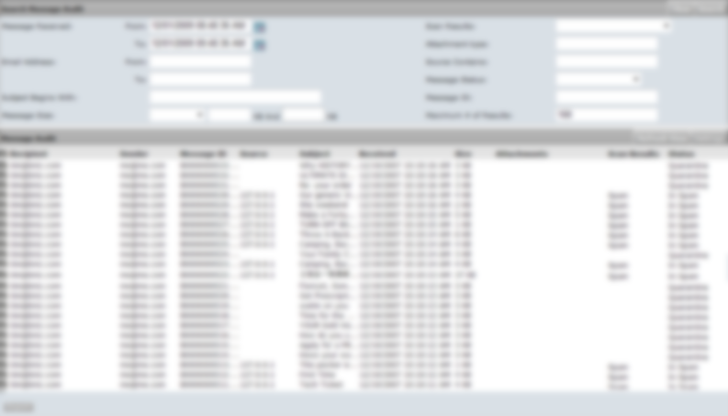
Additional Features
Designed to create a detailed change log

Slide 15
Additional Features
Designed to allow a centralized database repertoire

Slide 16
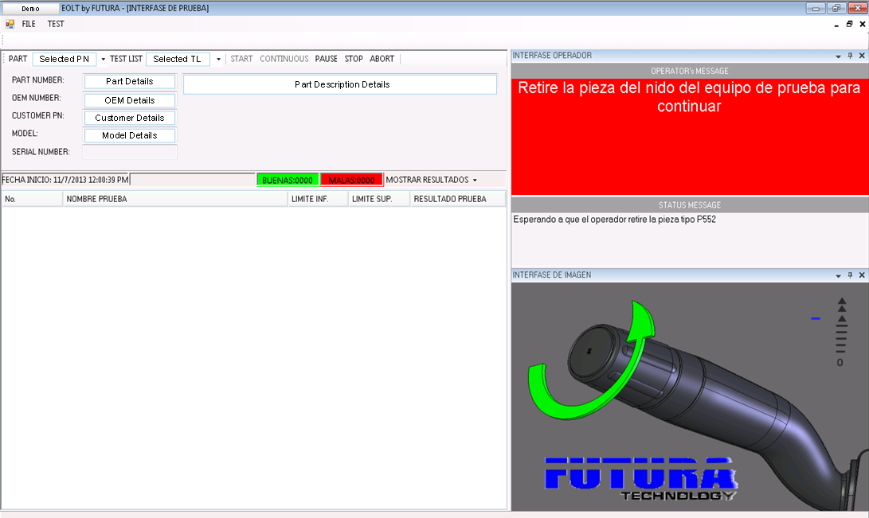
Designed to your customizable future

